Slide 1
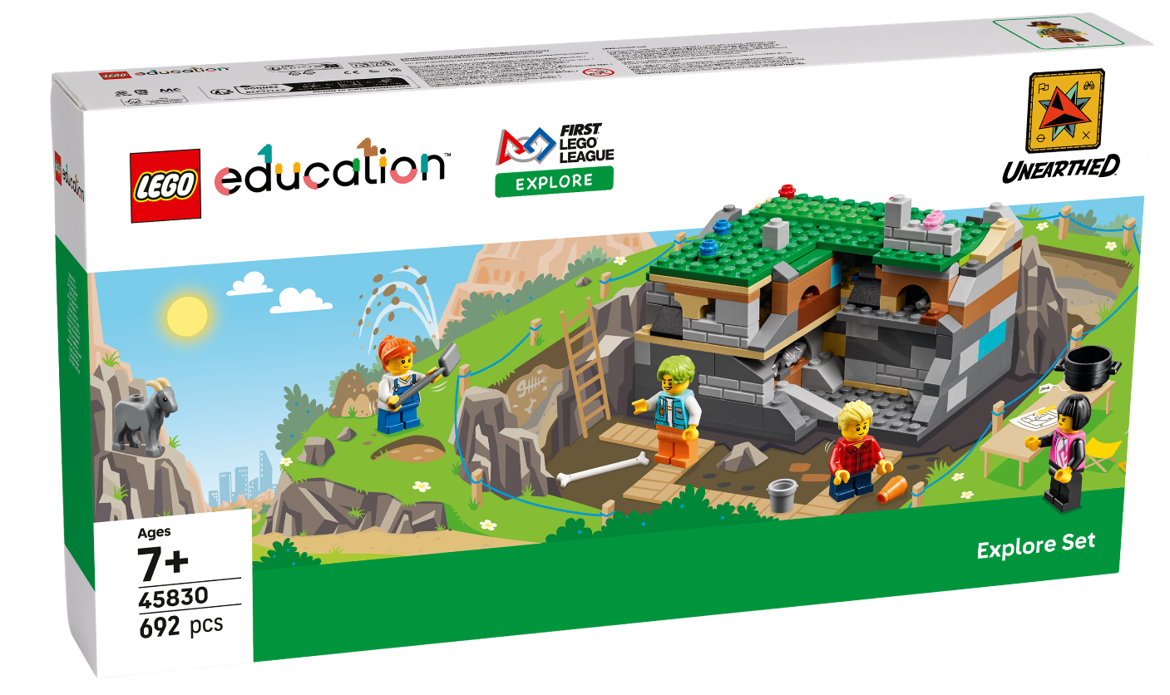


INTRODUCTION
Let’s Get Started

Slide 2
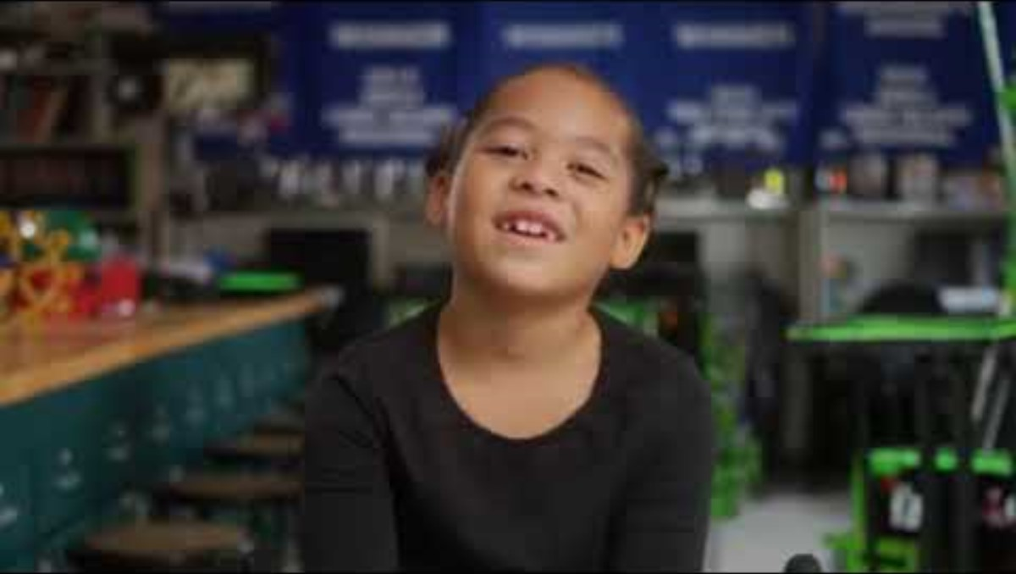
What is FIRST ® LEGO® League Explore?
Notes:
What is Explore video
YouTube link: https://youtu.be/afYrsiQ48wA

Slide 3
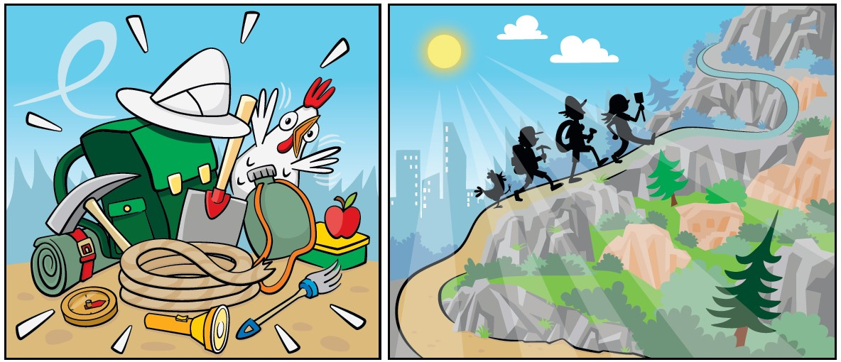
Explore Story
Notes:
Explore Story

Slide 4
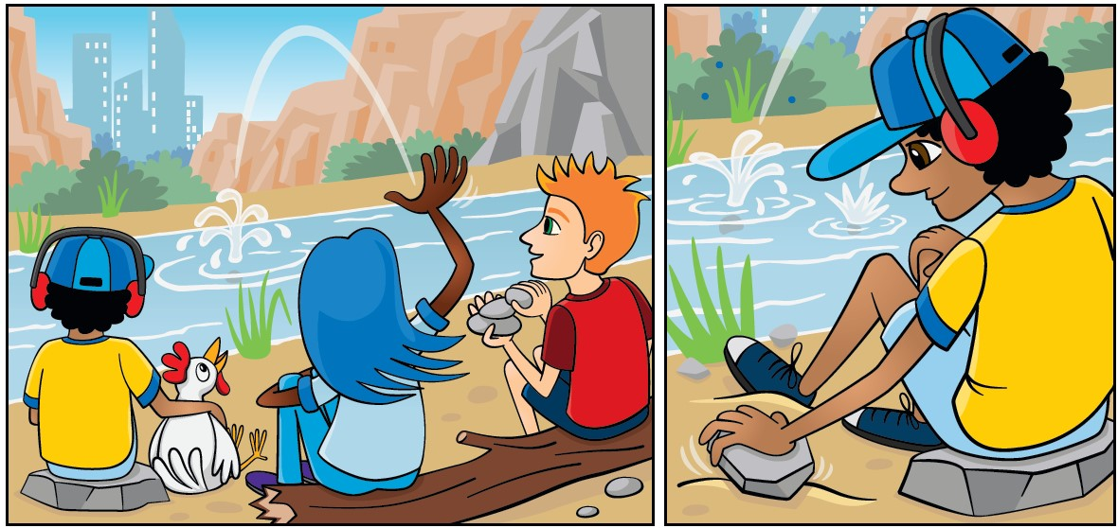
Explore Story
Notes:
Explore Story

Slide 5
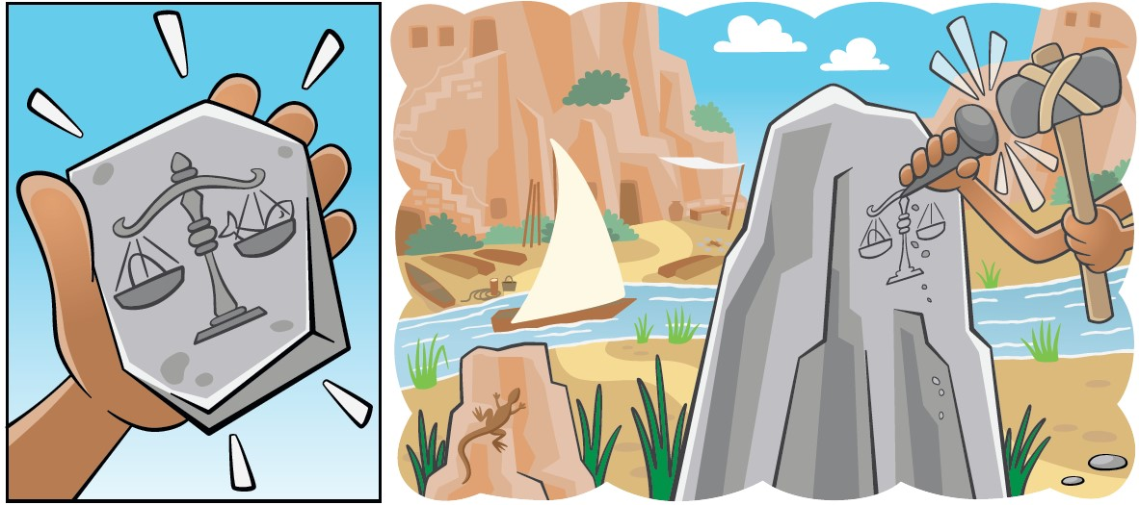
Explore Story
Notes:
Explore Story

Slide 6


Team Journey
Explore the Challenge
Learn about Core Values
Notes:
Team Journey
Working in Teams
Together with your teammates, you will:
Discover real-world challenges and opportunities in this season’s theme.
Create a team model and program it to make part of it move.
Test and improve your code and build changes.
Track your work in the Engineering Notebook.
Make a team poster that reflects your team’s journey.
Share your model and poster with reviewers at an Explore festival.
Celebrate your accomplishments with family and other teams at the festival.

Slide 7
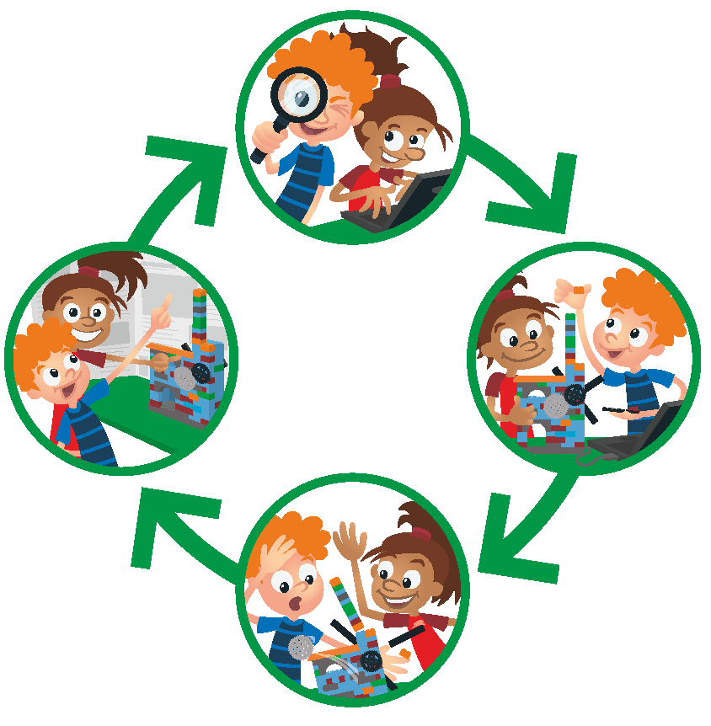

Team Journey
Engineering Design Process
Explore
Create Team Model
Share
Create
Test
Notes:
During each session, they will experience the engineering design process. There is no set order for this process, and they may go through each part several times in a single session. This means that during a session, children will be exploring the theme and ideas, creating solutions, testing them, iterating and changing them, and then sharing what they’ve learned with others.
Team Journey
Working in Teams
Together with your teammates, you will:
Discover real-world challenges and opportunities in this season’s theme.
Create a team model and program it to make part of it move.
Test and improve your code and build changes.
Track your work in the Engineering Notebook.
Make a team poster that reflects your team’s journey.
Share your model and poster with reviewers at an Explore festival.
Celebrate your accomplishments with family and other teams at the festival.

Slide 8
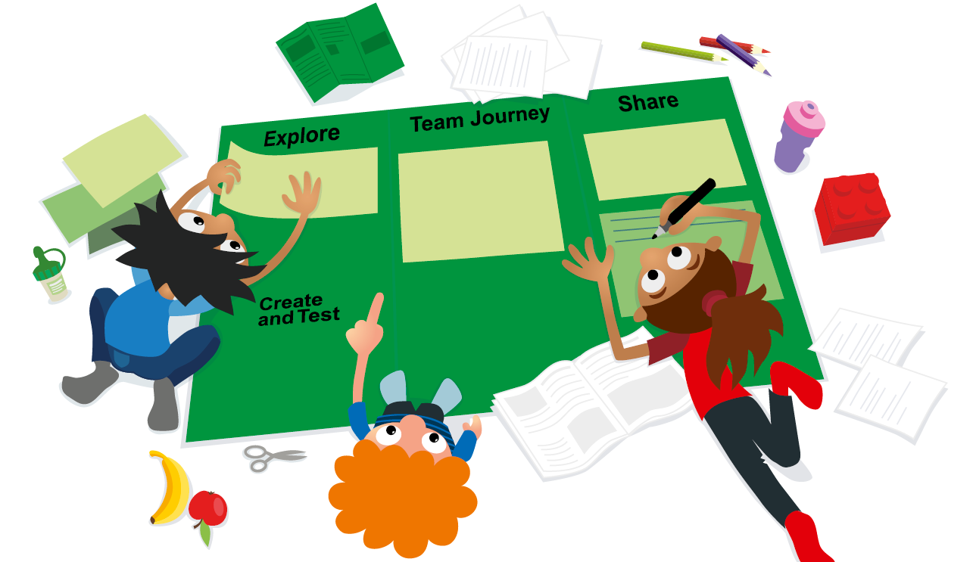

Team Journey
Make Team Poster
Celebrate at Festival
Team Journey
Share
Explore
Create and Test
Notes:
Team Journey
Working in Teams
Together with your teammates, you will:
Discover real-world challenges and opportunities in this season’s theme.
Create a team model and program it to make part of it move.
Test and improve your code and build changes.
Track your work in the Engineering Notebook.
Make a team poster that reflects your team’s journey.
Share your model and poster with reviewers at an Explore festival.
Celebrate your accomplishments with family and other teams at the festival.

Slide 9

Team Roles
LEGO® Element
Finder
Locates the specific LEGO elements needed for each build step.
Adult Facilitator
A coach, teacher, or mentor that guides the team through the sessions and their learning to achieve session outcomes.
Builder
Assembles the LEGO® models following the
building instructions.
Reporter
Captures the team’s
journey by taking
pictures or notes that
can be used at the
festival event.
Researcher
Writes down questions the team has about the season theme or activities and helps to look up answers.
Material Manager
Gathers materials needed for the session and returns materials at end of session.
Coder
Operates the device
and creates the
programs in the app.
Notes:
Here are sample team roles to use during the sessions. Everyone on the team could experience each role multiple times throughout their FIRST® LEGO® League Explore experience. Using roles helps the team function more efficiently and ensures that everyone on the team is engaged. Some roles will be filled by multiple children during a session. For example, the builder and coder roles can be duplicated where the experience is designed for a pair of children.

Slide 10
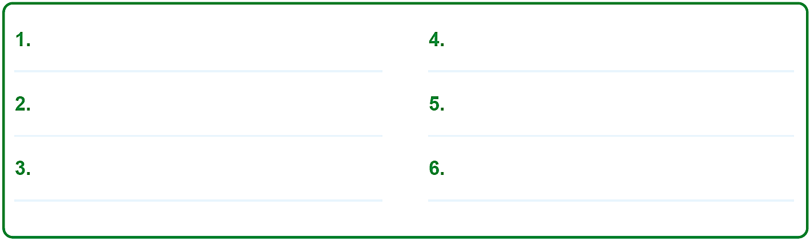
Form Your Team
Write your Team Members names in your Engineering Notebook, page 3.
Notes:
Now it is time to form teams of students and write their names in their Engineering Notebook, page 3.

Slide 11
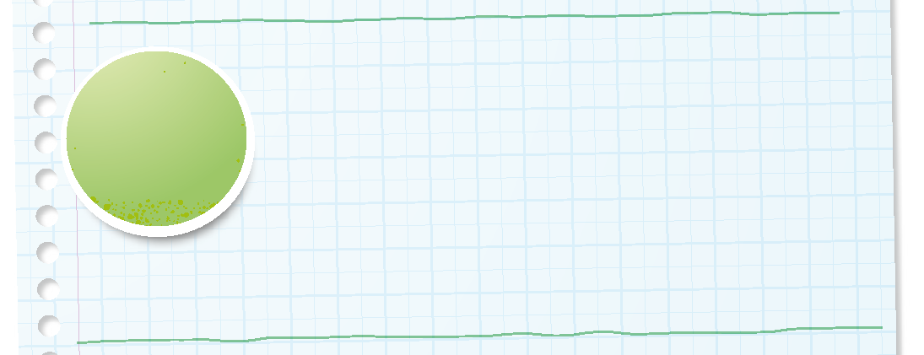
Goals for this season...
Write your goals in your Engineering Notebook, page 6.
My goals for this season are…
Notes:
Have the students reflect on what they think they want to learn with FIRST LEGO League Explore this season. Write these down in your Engineering Notebook.

Slide 12
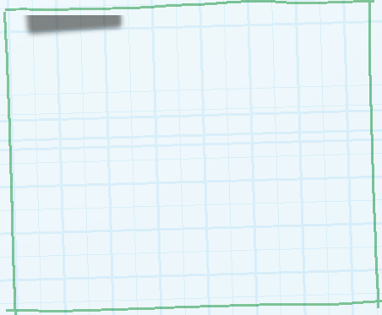
Core Values
DISCOVERY
INCLUSION
INNOVATION
TEAMWORK
IMPACT
FUN
Notes:
Throughout the season you will have your students refer back to page 7 of their Engineering Notebook to provide examples of how they demonstrated each Core Value.
Draw or write an example of your team demonstrating each Core Value when directed in the sessions!
Use the Core Values to guide your team through your journey.
Have lots of FUN as you develop new skills and work together.

Slide 13
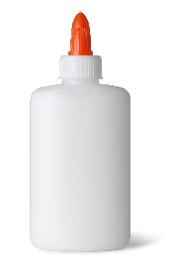
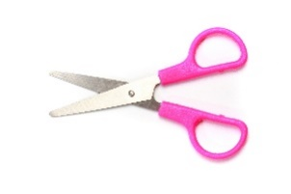

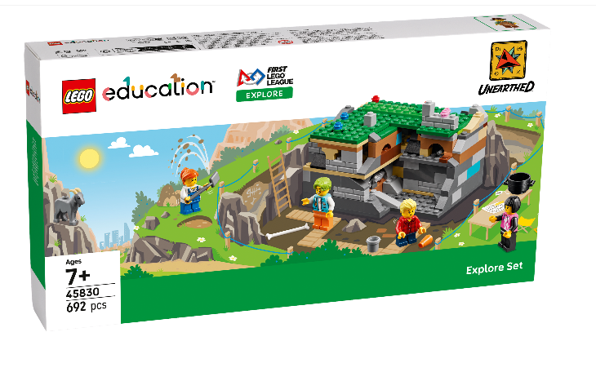
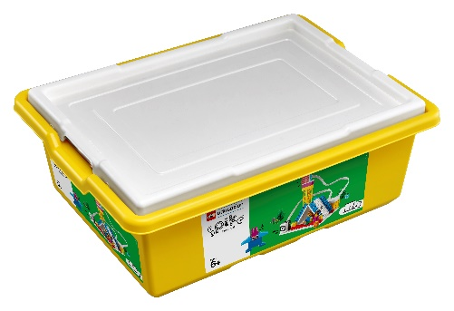


Materials
Each session lists the materials needed.
UNEARTHEDTM Explore Set
Notes:
You might provide any instructions your students need about managing materials during the Explore sessions.
Material Management
Place any extra or found LEGO® pieces in a cup.
Have the children who are missing pieces come to the cup to look for them.
Wait to dismiss your team until you look over their LEGO® set.
The lid of the LEGO® set can be used as a tray to keep pieces from rolling away.
Use plastic bags or containers to store any unfinished builds and their associated pieces or assembled models.
Designate a storage space for the built models, Explore set, and LEGO® container.
The role of the Material Manager is to help in the process of clearing away and storing materials.

Slide 14
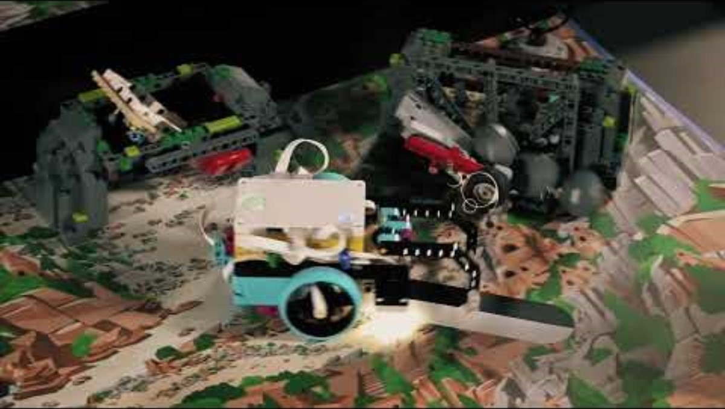

UNEARTHEDTM
UNEARTHEDTM
Visit the FIRST LEGO League YouTube Channel for more videos. Click "Play" to view the 2025-2026 UNEARTHED Season Playlist.

Slide 15
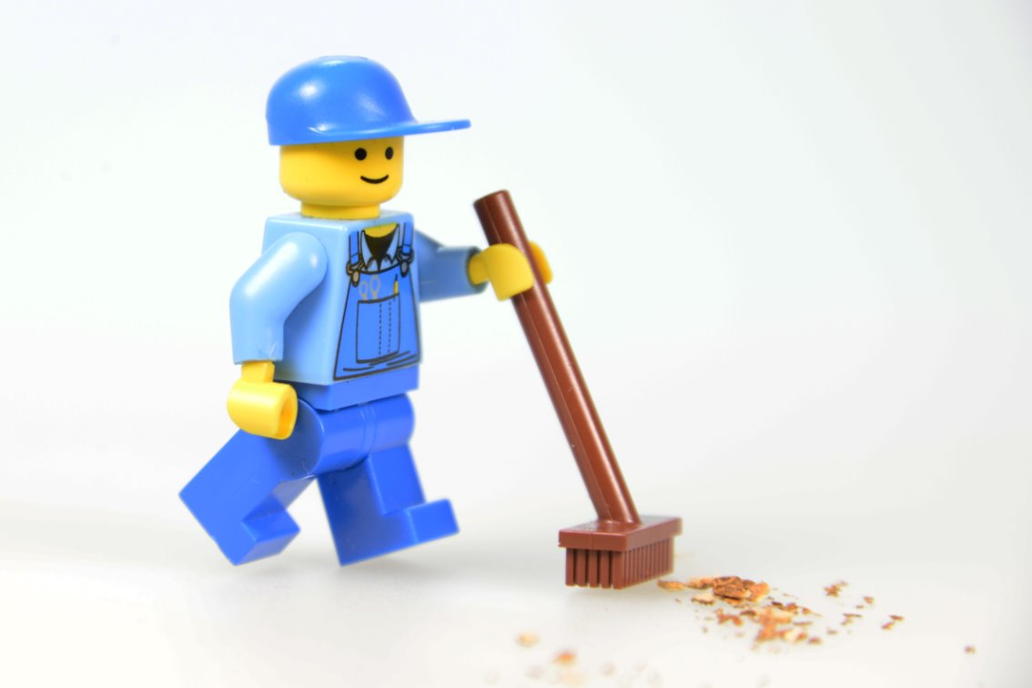
Clean Up

Slide 16


LEGO, the LEGO logo, and the SPIKE logo are trademarks of the/sont des marques de commerce du/son marcas registradas de LEGO Group. ©2025 The LEGO Group. All rights reserved/Tous droits réservés/Todos los derechos reservados. FIRST®, the FIRST® logo, and FIRST® AGE™ are trademarks of For Inspiration and Recognition of Science and Technology (FIRST). LEGO® is a registered trademark of the LEGO Group. FIRST® LEGO® League and UNEARTHED™ are jointly held trademarks of FIRST and the LEGO Group. ©2025 FIRST and the LEGO Group. All rights reserved.

